Slide 1

Unit tests and mock objects
45426: Teste e Qualidade de Software
Ilídio Oliveira
v2025-09-24

Slide 2
Learning objectives
Explain the practice of “tests in isolation”
Distinguish between mocks and stubs
For a given test case, identify which services should be mocked
Read and write (simple) unit tests using JUnit and Mockito

Slide 3
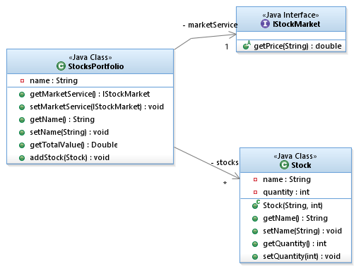
Unit testing assumes using units in isolation
Some methods of StocksPortfolio depend on online services
Unit tests verify the “local” contract
  StockPortfolio add/remove/find…
How about testing objects that require collaboration from others?
  StockPortfolio queries StockMarket to update rates
To keep the isolation:
  “fake” the behavior of the remote/real object/service
  Just enough logic to get the tests done

Slide 4


A
B
C
D
Collaborators
SuT (Subject under test)
A
B
C
Test scenario

Slide 5
Faking remote object behavior strategies
Stubs
  “Mini-implementation”, provides canned answers to calls made during the test.
  [Usually] not responding at all to anything outside what's programmed in for the test
Mocks
  Objects pre-programmed with expectations, i.e. specification of the interactions they are expected to receive.
  Verification will compare calls received against expectations.
In-container testing
  containers are activated (by the test runner) to enable the testing environment
  Requires mechanisms to deploy and execute tests in a container

Slide 6
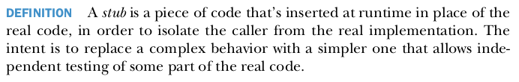
[Manual] Stubs approach: drawbacks
A
B
C
Stubs require implementing the same logic as the systems they are replacing
  Often complex… stubs themselves need debugging!
  Not refactoring-friendly
  Stubs don’t lend themselves well to fine-grained unit testing.
Use stubs to replace a full-blown external system
  a file system, a connection to a server, a database, ...
Need to partially implement B & C

Slide 7
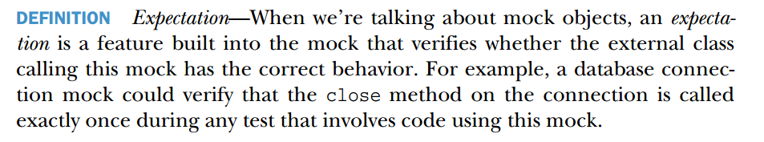
“Mocking” approach
A
B
C
The mock object is a test double
  Allows the test case to describe the expected calls
  The mock can check that, during the tests, all calls happened, with the right parameters, in the right order,…
  The mock can be instructed to return specific values
  Easy to “simulate” an expected scenario/behavior
B & C are “generated”: assuming defaults + declared expectations.

Slide 8
[Manual] Stubs
Mocks
Explicitly implements a simplified version of the target object behavior
  Contains some business logic
Usually coarse
Provides a generated object to respond to part of the target object’s contract
  No explicit implementation
  Automatic defaults (partially)
  Behavior specified by expectations
Fine-grained
  method level
  precise messages that pinpoint the cause of the breakage.

Slide 9
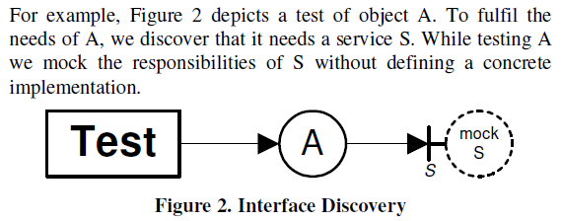
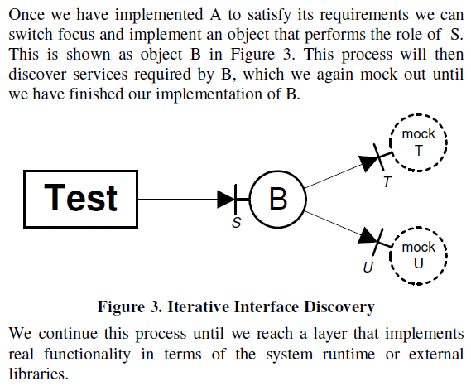
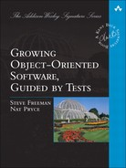
https://learning.oreilly.com/library/view/growing-object-oriented-software/9780321574442/

Slide 10
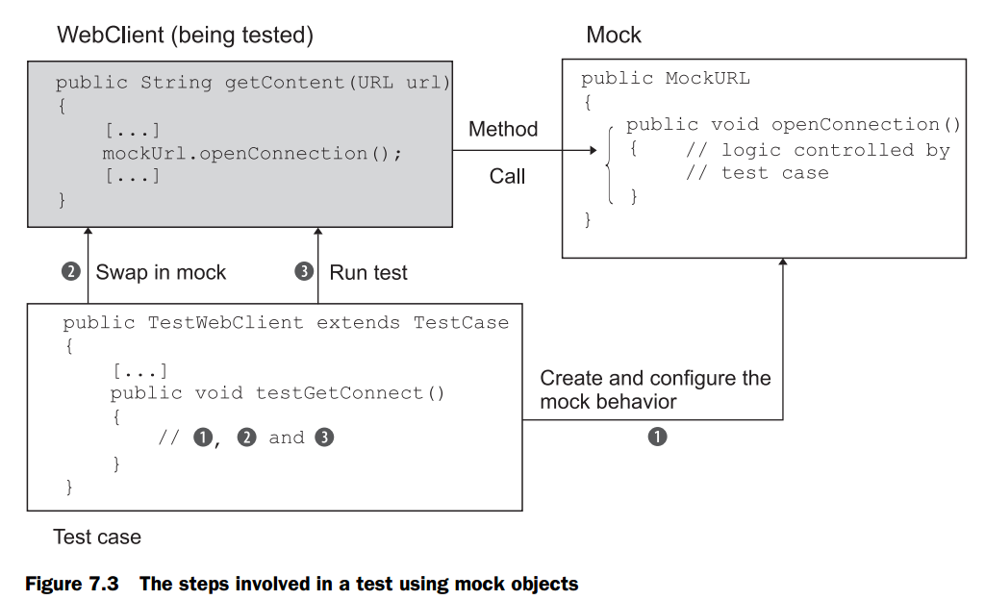

Slide 11
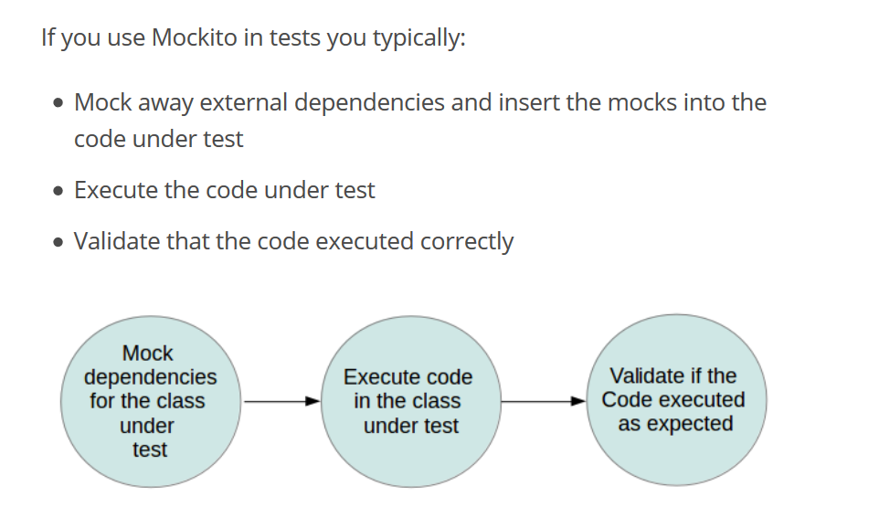

Slide 12
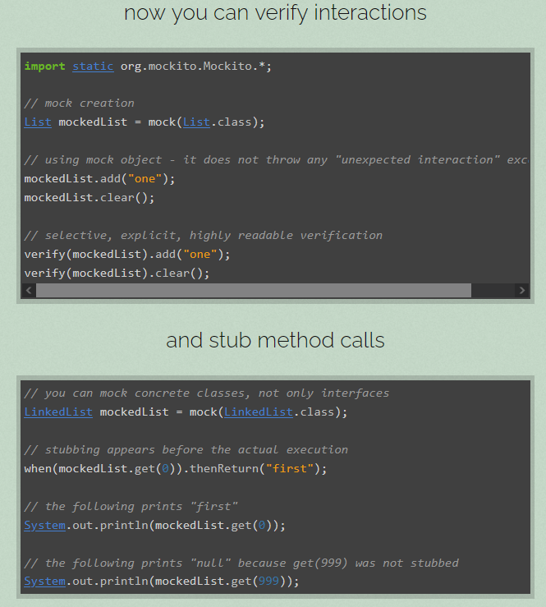
Inspect if/how the operations of interest were used.
(Test interactions, not the return values.)
Prepare canned responses.

Slide 13
Example
Method to test

Slide 14
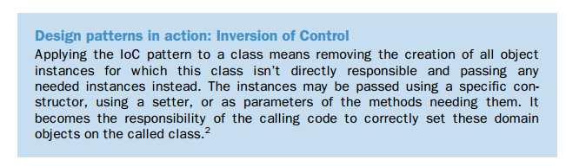
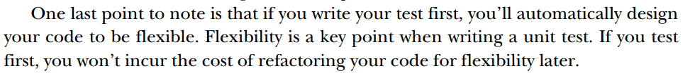
Pattern to help with testing

Slide 15
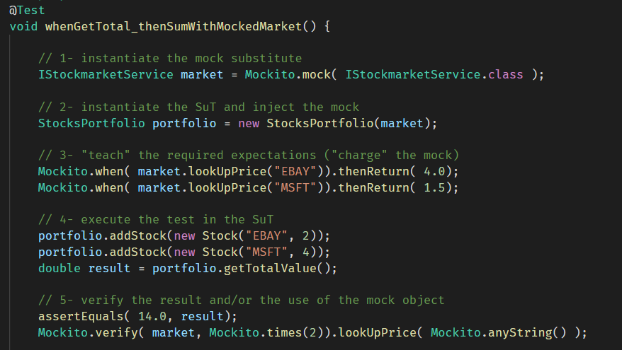

Slide 16
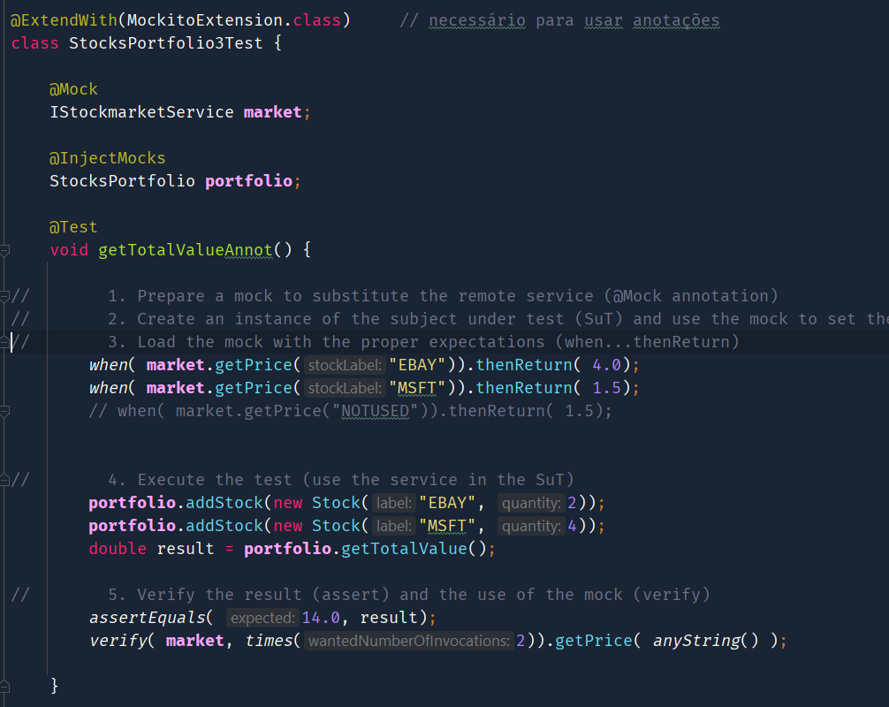



Slide 17
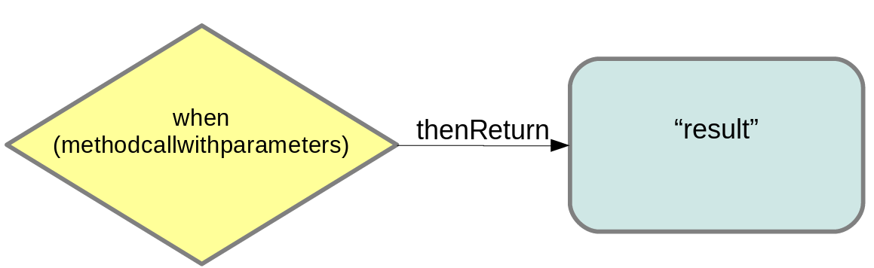
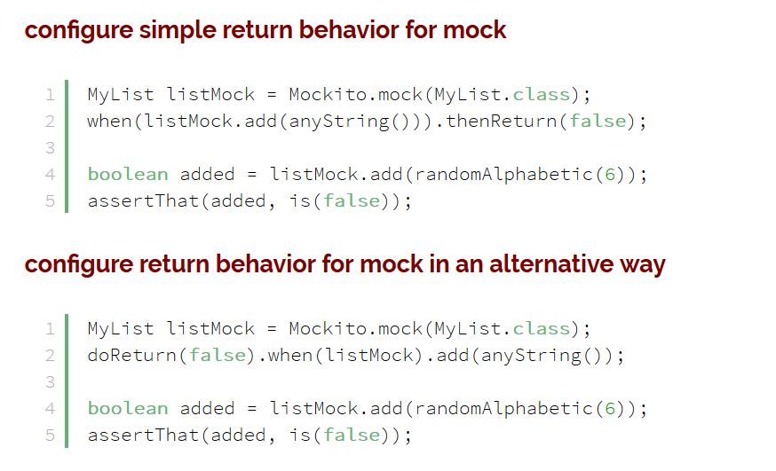
Simple expectations
https://www.baeldung.com/mockito-behavior

Slide 18
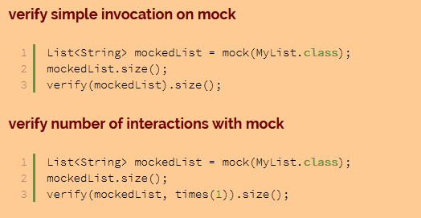
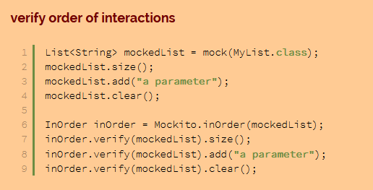
Mockito: verifying interactions (not only results)
https://www.baeldung.com/mockito-verify

Slide 19
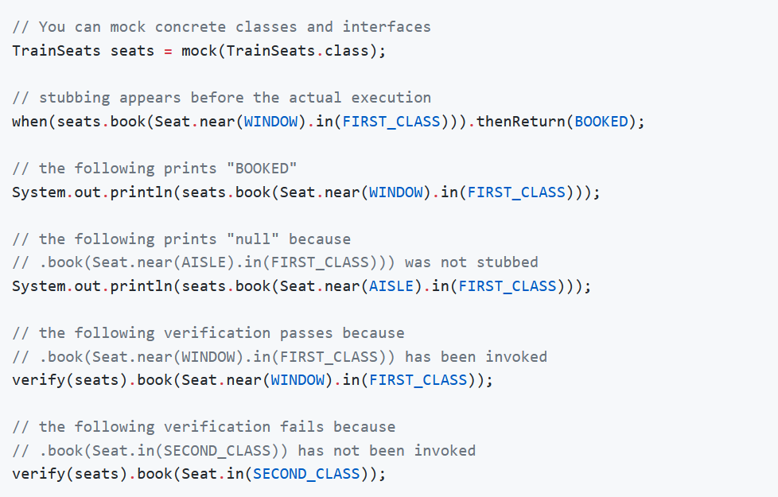
Example

Slide 20
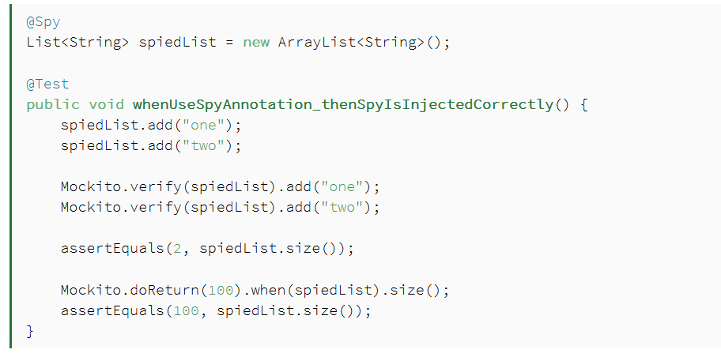

Spying
Note the test method naming style:
whenAction_thenExpected

Slide 21
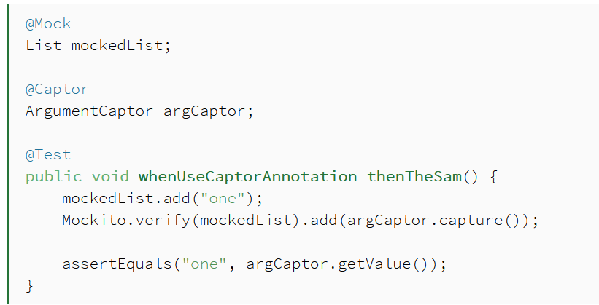
Captor

Slide 22
Mockito Annotations (requires enabling)
Annotation | Purpose
@Mock | create mocked instances (without having to call Mockito.mock() “manually”)
@Spy | partial mocking, real methods are invoked but still can be verified and stubbed. Every call, unless specified otherwise, is delegated to the object.
@Captor | Get the arguments used in a previous mock usage.
@InjectMocks | Use the created mock and inject it as a field in test subject

Slide 23
When to use a mock object?
supplies non-deterministic results
  e.g. the current currency exchange-rate or the current temperature.
has states that are difficult to create or reproduce
  e.g. a specific network error or database error.
is slow
  e.g. a network resource (latency).
module does not yet exist
  e.g.: TDD, a module to be later implemented → would have to include information and methods exclusively for testing purposes.
But do not use for…
  Data/value classes
  “Everywhere”….
  Careful about API/services you don’t control
If a mocked (3rd party) API changes, what happens?
to the test?
to the production code?

Slide 24
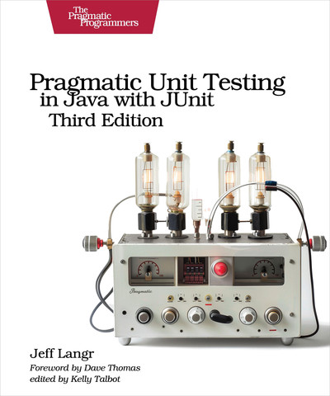
Danger zone!
Mocks supplant real behavior. Ask yourself if you’re using them safely.
  Does your mock really emulate the way the production code works? Does the production code return other formats you’re not thinking of? Does it throw exceptions? Does it return null? You’ll want a different test for each of these conditions.
Does your test really trigger use of a mock, or does it run real production code?
  Try turning off the mock and letting your code interact with the production class to see what happens (it might be as subtle as a slightly slower test run).
The code you’re mocking is getting replaced with a test double and is not getting tested.
  A mock represents gaps in test coverage. Make sure you have an appropriate higher-level test (perhaps an integration test) that demonstrates end-to-end use of the real class.
If a large number of tests require test doubles, you’re allowing your troublesome dependencies to proliferate too much. Reconsider the design.

Slide 25

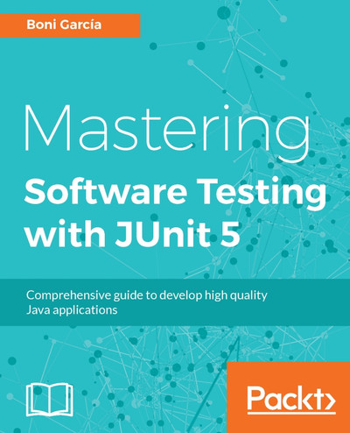
Best practices
https://github.com/mockito/mockito/wiki/How-to-write-good-tests

Slide 26
Assertion libraries

Slide 27
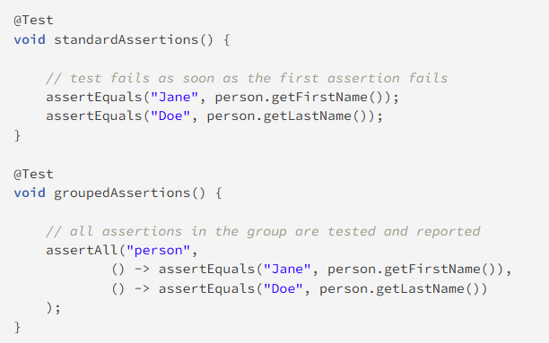
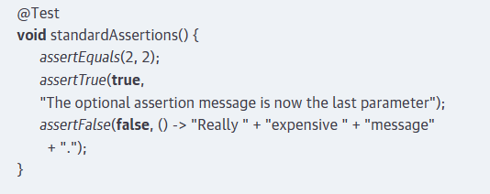
Jupiter assertions
Jupiter exceptions can be suplemented with a custom message to output when the test fails. If used, is the last parameter in the assert

Slide 28
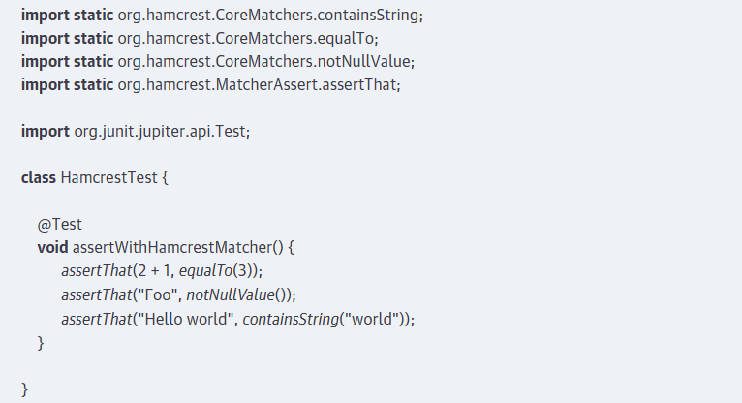
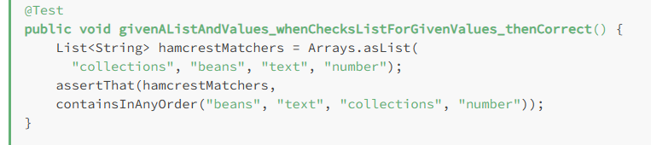


Hamcrest

Slide 29
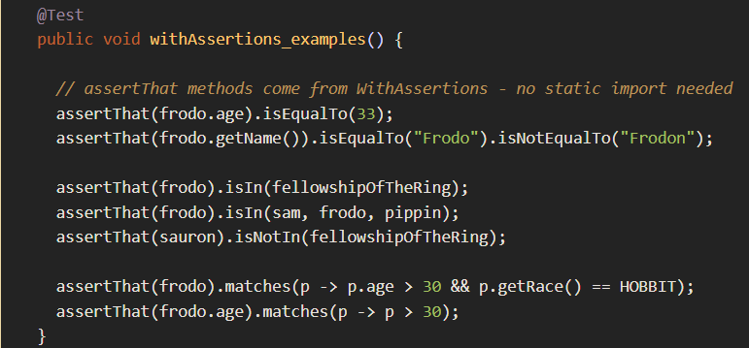
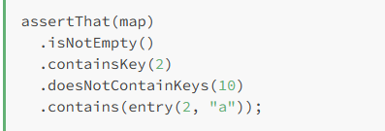
AssertJ
Note the support for method call chainning
“fluent API”

Slide 30
References
P. Tahchiev, F. Leme, V. Massol, and G. Gregory, JUnit in Action, Second Edition. Manning Publications, 2010.
Langr, J., Hunt, A. and Thomas, D., 2015. Pragmatic Unit Testing in Java 8 with JUnit. Pragmatic Bookshelf.
https://site.mockito.org/
https://www.baeldung.com/mockito-series
https://github.com/mockito/mockito/wiki/How-to-write-good-tests

